Slide 1

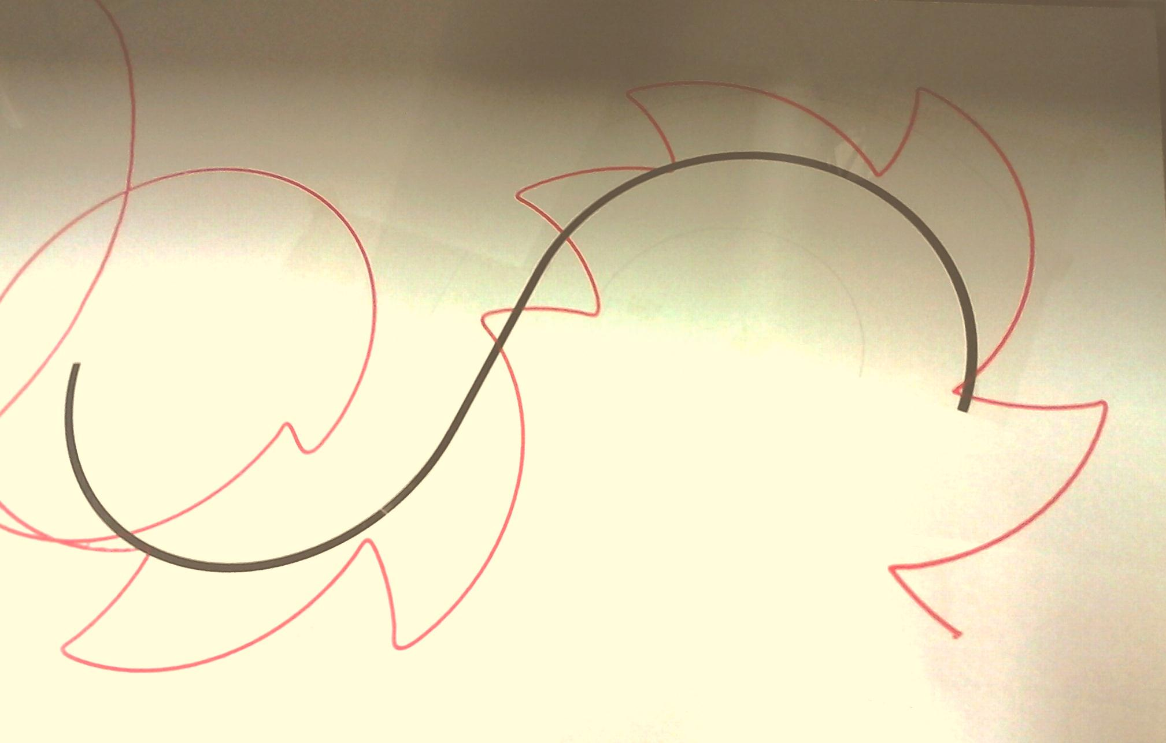
EEE First year Design Project
2014 – 2015 session
Dr Tom Tate
t.tate@ic.ac.uk
Phone 46208

Slide 2
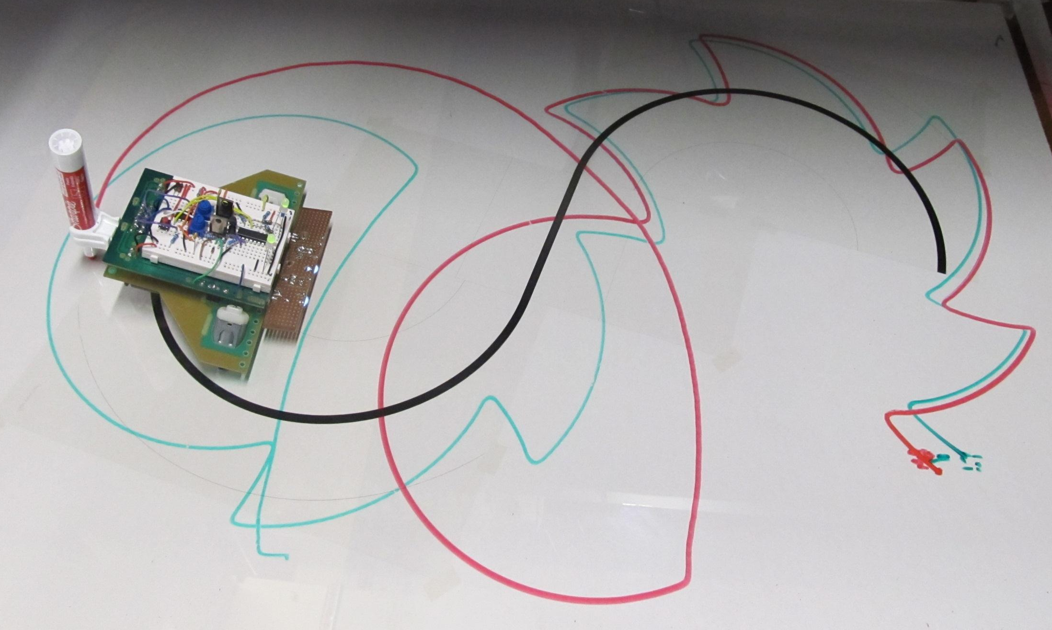
Design Project: Objectives
Self Education
  Look up what you do not know/understand
  Discuss topics in a group
Creativity
  Have an inquisitive mind
  Experiment
  Try out your ideas and explain the results

Slide 3
Design Project: Motivation
Engineering is team work
  Apply 1st year courses to ‘real life’ engineering problem
    Application of expertise
  Learn how to design
    Formalise the design process
  Learn to cope with new subjects
    Creativity

Slide 4
Design brief for CRAWLEE
Each group must design and implement an improved eebug, which will follow a track marked in black on a white background, leaving a mark to show where it has been.
At the end of the track, (within 5 cm) it must continue straight for 20cm, then draw a spiral with decreasing radius, completing at least one full turn before stopping.
Budget: Toy enhancements must not exceed £8 per bug

Slide 5
The “snail trail”
The bug will “hold” a whiteboard marker (supplied), so that it leaves a trace of it’s path
The playing field dimensions are 1250 x 610 mm

Slide 6

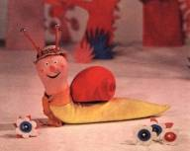
The track (1)
Polycarbonate cover
White (A1 size) paper with pattern
Benchtop
Polycarbonate is 1250 x 610 x 1 mm

Slide 7
The track (2)
Bug continues straight for 20 cm
Blue represents the bug trajectory
Track width approx. 6 mm
Start
Minimum curve radius 12 cm
At least one complete turn in spiral – Then STOP
NB the shape of the black line is only a representation and may differ in the final test!

Slide 8
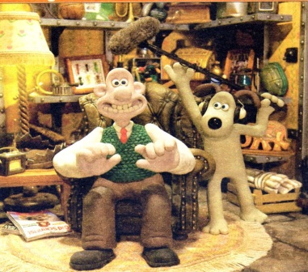
…the small print…
Maximum of two sensors.
All circuit nodes must be represented on the single supplied breadboard.
Maximum of 4 AA batteries.
Completely autonomous: no operator intervention after turn-on.
The Basic bug architecture may not be changed (eg you can’t relocate / upgrade the motors…)

Slide 9
…more small print…
If using microprocessor, may not exceed 8 pin device (and only one device!!)
There may be short (<11mm) breaks in the track
The bug must not be confused by uneven lighting conditions
Must have a single switch (or equivalent) to start – making a breadboard connection is not acceptable
Logbook must include single page of instructions

Slide 10

Batteries & Pen
The bug should work even with “Used” batteries – batteries are ok if > 4A for 5 seconds when shorted through AVO set to 10A DC range
  Use the online BATMAN order form for extra batteries (link on labweb)
Use BATMAN for the pen (Berol Part Number: S0368870 : cost does NOT form part of the budget)

Slide 11
Superbugs
Functions beyond the design brief can attract extra marks:
Parts 2 & 3 have extra marks* available for superbugs
Extra functions could be…
  remote start, increased speed, avoiding collisions, power saving, status indication…etc
* See Marking scheme on Labweb

Slide 12
WWW?
What Went Wrong last year?
  Electrical noise
  No measurement
  Assumption that software fixes everything

Slide 13
Group composition
Planning and Management
Groups: Groups are based on tutors’ initials
  eg PANA {Patrick Naylor’s A groups},…
Group Leader, Secretary, Treasurer, Countersignatory
  see listing on labweb
  Arbitrary assignment can be changed

Slide 14
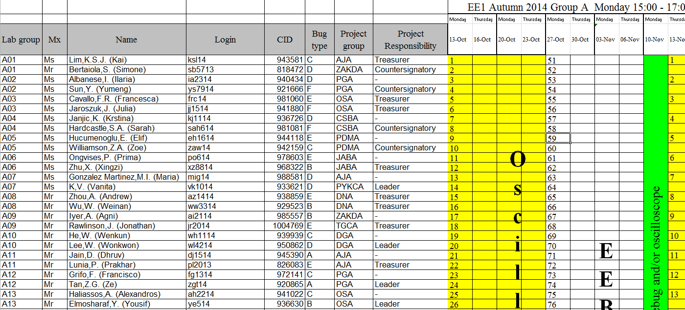
Group composition

Slide 15
How will the project work?
The design is formalised into three stages:
Stage 1(Group)
Introduce Design Issues
Investigate work area
Learn SPICE
Management
Stage 2 (Group)
Propose improvements
Top level design
Low level design
Prototyping
Stage 3 (Individual)
Build and test demonstrator system
Extra – implement on PCB

Slide 16
Stage 1 overview
Autumn term
  Planning & Management
  Investigate existing toy (1st year lab experiment)
  Introduction to SPICE simulation
  Propose enhancements to toy
  Upload report to Blackboard, by end of term

Slide 17
Resources (stage 1)
1st year lab experiments
Labweb https://intranet.ee.ic.ac.uk/intranet/labweb/
  Includes archive of FAQs from previous years
PSPICE on networked EED computers
Blackboard https://bb.imperial.ac.uk/

Slide 18
Stage 1
Project management
  Set up meeting schedules
  Set up communications
  Agree how to manage personnel issues
  Agree how to manage red flag issues
  Record progress
    Team meetings (minutes)

Slide 19
Stage 1
Project Planning
  Define the task(s)
    Break down into sub tasks
  Assign responsibilities
    Select sub-groups & tasks
  Assign workpackages
    Planning (time plan)
    Define success criteria

Slide 20
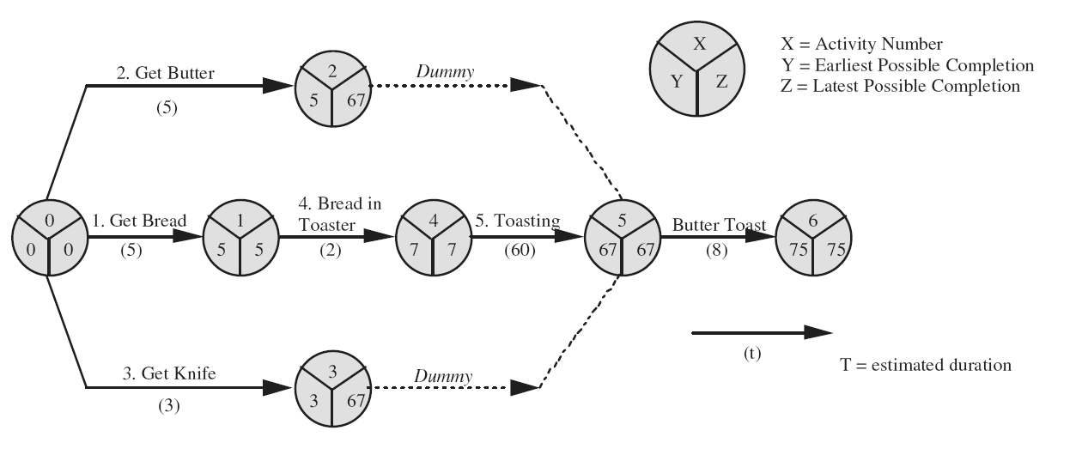
Stage 1
Time Plan
Different ways to illustrate interdependencies, deadlines, milestones
Interdependency chart

Slide 21
Stage 1
Time Plan
Or a Gant chart:

Slide 22
Stage 1
Team meetings and minutes
Example:
  Meeting: 21/11
  Present: A. Andrew , B. Brian, C. Cleaver,
  Apologies: D. Drake
  Absent: E. Edwards
  Issues from previous meeting:
  Work to be completed by Friday night
  Action Points:
  E. Edwards simulates all circuits by 12/12
  A. Andrew writes report by 19/12

Slide 23
Stage 1
Basic investigations
Complete (individual) Bug experiment
Discuss results within the group
Define good and bad points of initial bugs
Discuss simulations and their merits / shortcomings

Slide 24
Stage 1
Propose enhancements
Propose a method in broad outline (your final design may differ from this!)
Project planning, milestones, deliverables, etc.
Decide how to organise your team and what to do when things go wrong

Slide 25
Stage 1: To be completed by end of Autumn term
Upload cover page and report to Blackboard, by 23.59 19th Dec 2014
Report contains:
  Management
  Planning
  Collated Eebug data: define the starting point
  Broad outline of enhancement
Everyone contributes to the report!
Only the group Secretary will be able to submit the report

Slide 26
Submitting reports
Reports for stages 1 & 2 will be uploaded to Blackboard (Turnitin plagiarism check).
Only the group secretary will have access.
Upload details will be published on labweb:
  Cover page
  Word limit
  Format (pdf: Must have selectable text)
  Any other upload instructions
I’ll publish this mid-november, once I’ve sorted out Blackboard !

Slide 27
Stage 2 Overview
Spring Term
Enhance the toy functionality
  Planning & management
  Top level and low level design
  Discuss results, application
  Blackboard design submission deadline at end of term

Slide 28
Resources (stage 2)
Access to prototype budget £8 per group
  Total project budget is £8(n+1), n people in the group
Use of lab
Expenditure must be requested by group treasurer and authorised by the countersignatory (web form on labweb)

Slide 29
Stage 2
Detailed design and testing, leading to agreed circuit
  Low and high level design of circuits
  Testing of subcircuits
  Integration of circuits into single package
  Final circuit design
  Submission of design report

Slide 30
Stage 2
1 week of lab time set aside for project work in the middle of Spring term
Nominal Stage 2 budget is £8 per group
  (but could be greater so long as total budget is not exceeded)

Slide 31
Stage 2: To be completed by end of spring term
Upload report to Blackboard, submission deadline 27th March 2015
Report format will be detailed on labweb
Aim to complete group component requisition by 20th April (to avoid delays in the Summer term)

Slide 32
Stage 3 Overview
Summer Term
Individual build and test of toy
Individual viva voce demonstration
Possibility of (Group or individual) PCB design

Slide 33
Resources (stage 3)
Group budget £8 per member
  Total group budget = £8x(1+Number in group)
Use of lab

Slide 34
Stage 3 Details
Build and test on breadboard
Individual viva with lab demonstrator
Decision about final (extra) stage, of realising bug on printed circuit (to be implemented after exams, before the end of term!)

Slide 35
Stage 3
Individual build and presentation
Individual build (taking into account feedback from marker) and test
Stage 3 budget is £8 per individual
(Submission of PCB design)
Individual viva voce demonstrations on Tuesday 19th May 2015

Slide 36
Assessment
Electrical lab Coursework amounts to 25% of part1
Electrical laboratory 15% (60%)
Group Design Project 10% (40%)
The overall coursework pass mark (including assessments from other modules) is 40%.

Slide 37
Assessment breakdown
First report 22%
Second report 33%
Viva voce 45%
Individuals have to pass the viva in order to be credited with the group marks for the first & second reports
Marking schemes available on labweb

Slide 38
Extra
Not assessed
But you can keep it!
Make PCB with finalised design, after exams, bug races…

Slide 39
More Extra
We hope to award a “BP prize” on the basis of this project…

